Slide 1
Eosinophilic Oesophagitis and Non-GERD oesophagitis
Dr. P. R. Sisir

Slide 2
Eosinophilic oesophagitis
The oesophageal epithelium in eosinophilic oesophagitis is infiltrated by eosinophils, typically in a density exceeding 15 per high-power field (hpf).
Presenting symptoms include:
vomiting,
feeding problems,
chest or epigastric pain, and
dysphagia with occasional food impactions or strictures.

Slide 3
Epidemiology
Most patients are male.
The mean age at diagnosis is 7 yr (range 1-17 yr), and the duration of symptoms is 3 yrs.
Most patients have other atopic diseases and associated food allergies…
Laboratory abnormalities can include peripheral eosinophilia and elevated immunoglobulin E (IgE) levels.

Slide 4
Endoscopically, the oesophagus presents a granular, furrowed, ringed, or exudative appearance.
Oesophageal histology reveals eosinophilia, with cut-points for diagnosis variably chosen at 15-20/hpf.
Up to 30% children have grossly normal oesophageal mucosa.

Slide 5
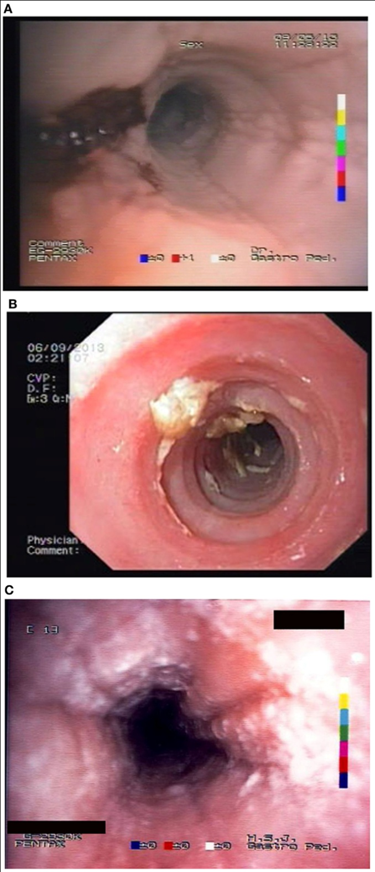
Endoscopic image of eosinophilic oesophagitis with characteristic mucosal appearance of furrowing and white specks.

Slide 6
D.D. with gastroesophageal reflux disease
It is differentiated from gastroesophageal reflux disease (GERD) by its:
general lack of erosive esophagitis,
greater eosinophil density,
its refractoriness to antireflux therapies.
Gastroesophageal reflux disease may be an important co-existing diagnosis.
Evaluation of Eosinophilic oesophagitis should include a thorough search for food and environmental allergies via skin prick (IgE mediated) and patch (non–IgE mediated) tests.

Slide 7
Treatment
Involves dietary restrictions that take one of 3 forms:
elimination diets guided by circumstantial evidence and food allergy test results;
“six food elimination diet” removing the major food allergens (milk, soy, wheat, egg, peanuts and tree nuts, seafood);
elemental diet composed exclusively of an amino acid–based formula.

Slide 8
Successful clinical and histologic remission is observed in 70 - 98% patients.
Little is yet known about its natural history, but it seems that Eosinophilic oesophagitis is a chronic remitting and relapsing disorder with a potential for complications such as stricture formation.

Slide 9
Non-GERD oesophagitis
Infective oesophagitis
Uncommon, and most often affecting immunocompromised children, infective oesophagitis is caused by fungal agents, such as Candida and Torulopsis glabrata; viral agents, such as herpes simplex, cytomegalovirus, HIV, and varicella zoster; and, rarely, bacterial infections, including diphtheria and tuberculosis.
The typical presenting signs and symptoms are odynophagia, dysphagia, and retrosternal pain; there may also be fever, nausea, and vomiting.
Diagnosis of infectious oesophagitis is made by endoscopy (ulcerations, exudates) and histopathologic examination

Slide 10
Non-GERD oesophagitis
“Pill” Oesophagitis
This acute injury is produced by contact with a damaging agent.
Medications implicated in “pill” oesophagitis include tetracycline, potassium chloride, ferrous sulfate, non-steroidal anti-inflammatory medications, and alendronate (Rx usually given for osteoporosis).
Most often the offending tablet is ingested at bedtime with inadequate water.
This practice often produces acute discomfort followed by progressive retrosternal pain, odynophagia, and dysphagia.
Endoscopy shows a focal lesion often localized to one of the anatomic narrowed regions of the oesophagus or to an unsuspected pathologic narrowing.
Treatment is supportive; lacking much evidence, - bland or liquid diets are often used.

Slide 11
THANK YOU…

